Slide 1

An Introduction to
Online Assessment with Avenue
Department of Mechanical Engineering
McMaster University
Developed by the On-Line Teaching Committee
Elizabeth Hassan
Marilyn Lightstone
Eu-Gene Ng
Gregory Wohl

Slide 2

During this workshop you will learn about:
The advantages of online assessment using Avenue
The various types of online assessments and which type suits your own course
How to assign work?
How to grade work?
How to manage student absences or extensions?
0:08

Slide 3
Using Avenue for Online Assessment
Advantages
  No need for another log in or software, every student and TA has access
  Data is secure, no IP issues
  Official university platform so students take it seriously
  All entries time/date stamped
0:37

Slide 4
Using Avenue for Online Assessment
Advantages
  Automatic grade entry, students can see their grades in one place
  Handles group and individual work
  Graduate attributes possible from rubric data
  Easy to manage multiple TAs and make grade corrections if necessary
1:23

Slide 5
Keep in mind:
When I say “you” I actually mean “you and your TAs”
A lot of this work is suitable for TAs, I find they pick up Avenue really quickly
We are planning departmental TA training on this
2:07

Slide 6
A Spectrum of Online Assessment Approaches
There are many ways to assess students
Examples
Multiple choice quizzes
Scanned written assignments, reports or midterms
Manual grade entry for presentations
2:36

Slide 7
Method #1
Multiple Choice Quizzes
SELF GRADING
Comments
Ideal for quick post-lecture content quizzes
Results can automatically appear in grade book
I often let students drop their worst few quizzes, this is easy to set up using Categories in your grade book
If you are using the results during class, I prefer to access Avenue on a separate screen (like my phone) so I don’t accidentally share student data with the class
2:50

Slide 8
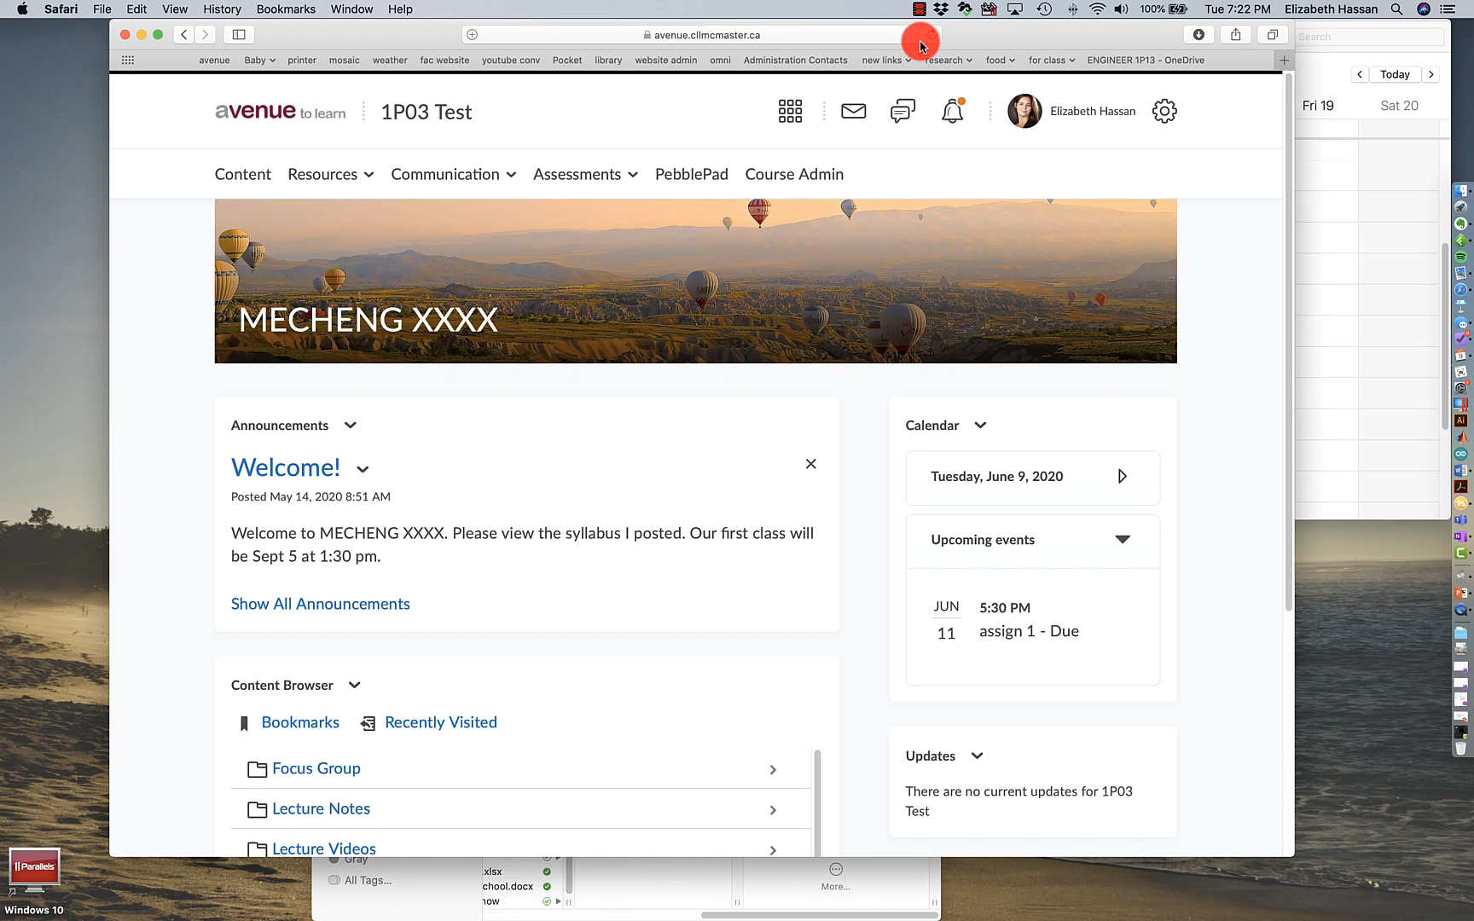
Video: Making a multiple choice quiz
4:17

Slide 9

Method #1B
Non-Multiple Choice Quizzes
NOT SELF GRADING
Comments
These can be short written responses
Suitable if you want to give part marks for a numerical problem, or have multiple versions of a quiz like Eugene
Manually graded by TA
5:18

Slide 10
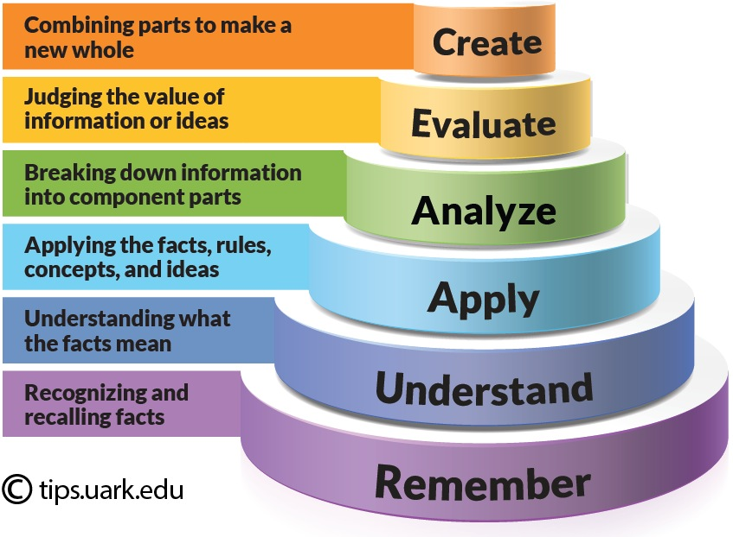
On-Site Proctored and On-Line Non Proctored Assessments
On-Site Proctored Assessments
Assistance [Open book, Crip sheet, formula sheet…. ]
Instructor have control
20% Remember, 30% Understand, 30% Apply, 15% Analyze, 5% Evaluate
2 hrs
3 hrs
4 hrs
On-Line Non Proctored Assessments
Assistance [Open book, Crip sheet, formula sheet, mathematical software, social media, real-time chat group.... ]
Instructor have no control
20% Understand, 40% Apply, 25% Analyze, 15% Evaluate
5 hrs
6 hrs
The learner finds it more difficult for On-Line Non Proctored Assessments.
The instructor will need more time to create assessment questions for On-Line Non Proctored Assessments. (Ask CM about Year 1 Math)
6:04

Slide 11
Multiple Choice Questions with
Multiple Answers
Student can select one, two or four answers.
  No marks will be awarded if three answers are selected or when [e] is selected with another answer.
In this example, there is only one correct answer.
  Scoring
    [e] 0 mark,
    [a,b,c,d] 0.5 marks
    [c,d] 0 marks
    [a,b] 1 marks
    [b], 2 marks
12:54

Slide 12

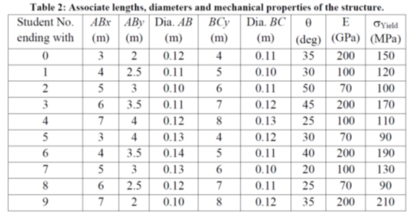
Non Multiple Choice On-Line Assessments
All student will attempt the question on buckling which has pin fixturing and a force applied at a specific orientation.
The geometry, force magnitude, orientation of the force and yield strength of the material is dependent on the student number ending with.
The level of difficulty is the same for all students.
17:27

Slide 13
Non Multiple Choice On-Line Assessments
Generate marking scheme
On the marking scheme,
"milestone"
needs to be specific for marking and later when student wants to review their assessment
21:01

Slide 14
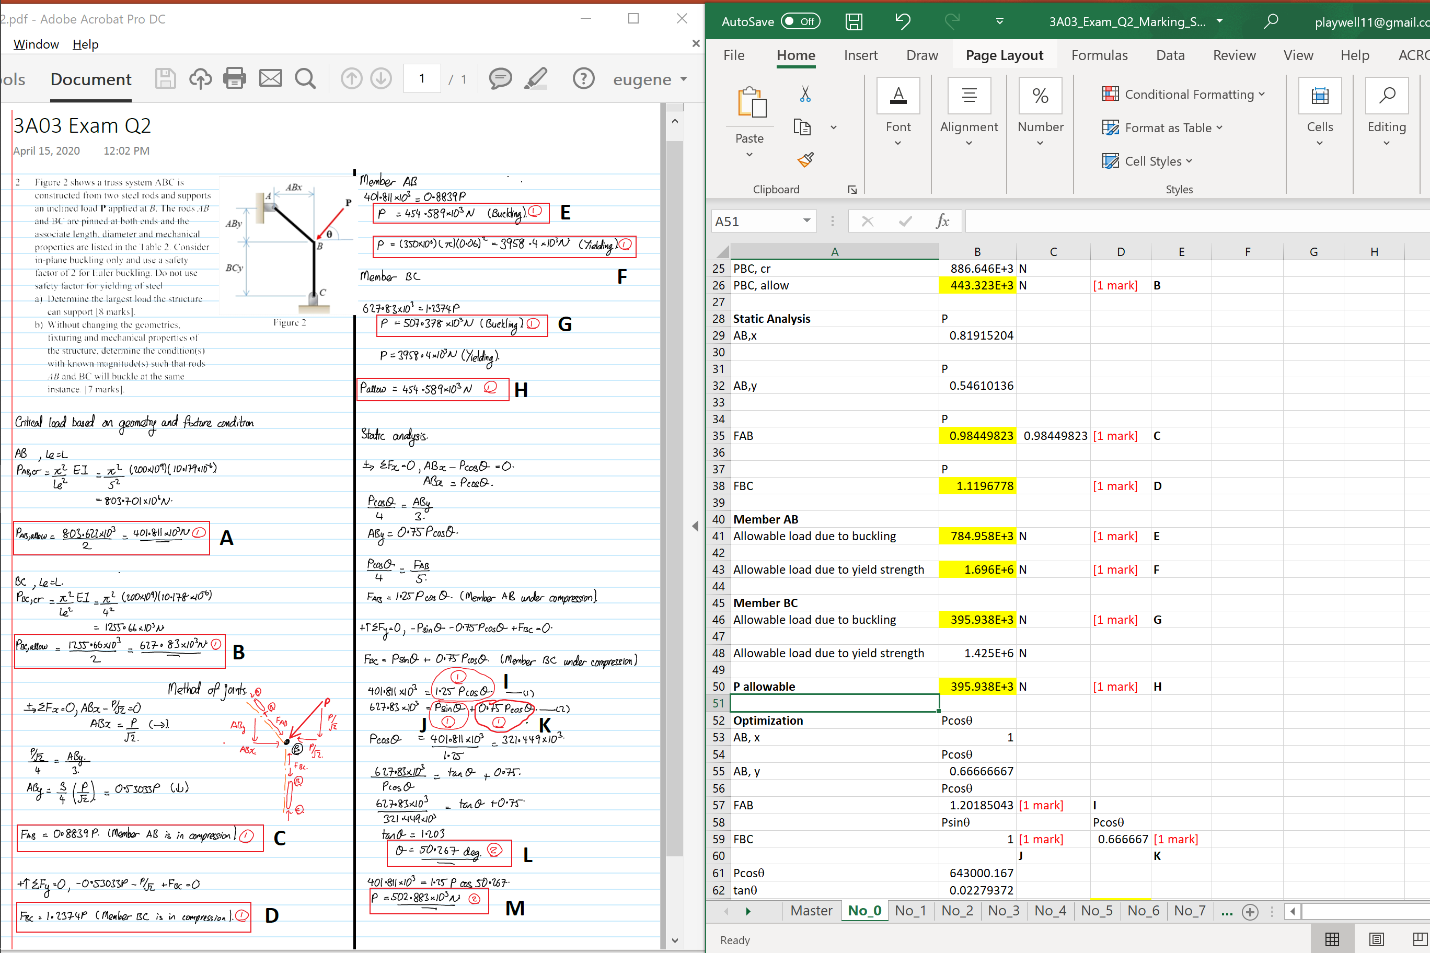
Non Multiple Choice On-Line Assessments
Student number ending with
Using Excel to generate marking scheme on multiple version for evaluation.
Demo
22:11

Slide 15
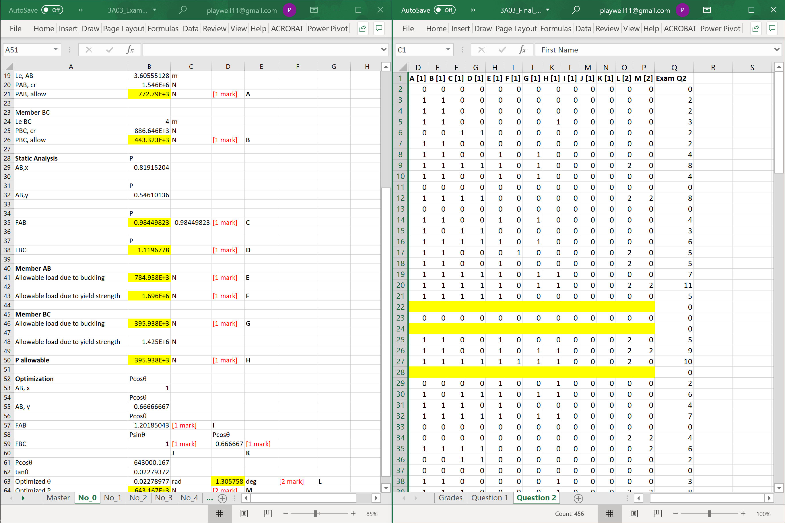
Non Multiple Choice On-Line Assessments
Importance of the "Milestone"
24:23

Slide 16
Non Multiple Choice On-Line Assessments
MECH ENG 3A03
Basic knowledge on Avenue to learn is required.
With the current method of assessment, no significant different in grade distribution was observed.
  However more student got D in W2020. This is because the passing grade was 45% (special case).
Class averages were 61% for W2019 and 58% for W2020
25:13

Slide 17
Method #2
Scanned Assignments or PDF reports, projects, exams
Example – problems sets, projects
Comments
Can use your existing assignments
Easiest if students upload a single PDF
I’m strict on legibility and format, with a big deduction if they submit something the TAs will struggle to read
Our summer students are making universal guidelines for student document digitizing
Rubrics are really useful: students get feedback and TAs have a guide to work from
31:45

Slide 18
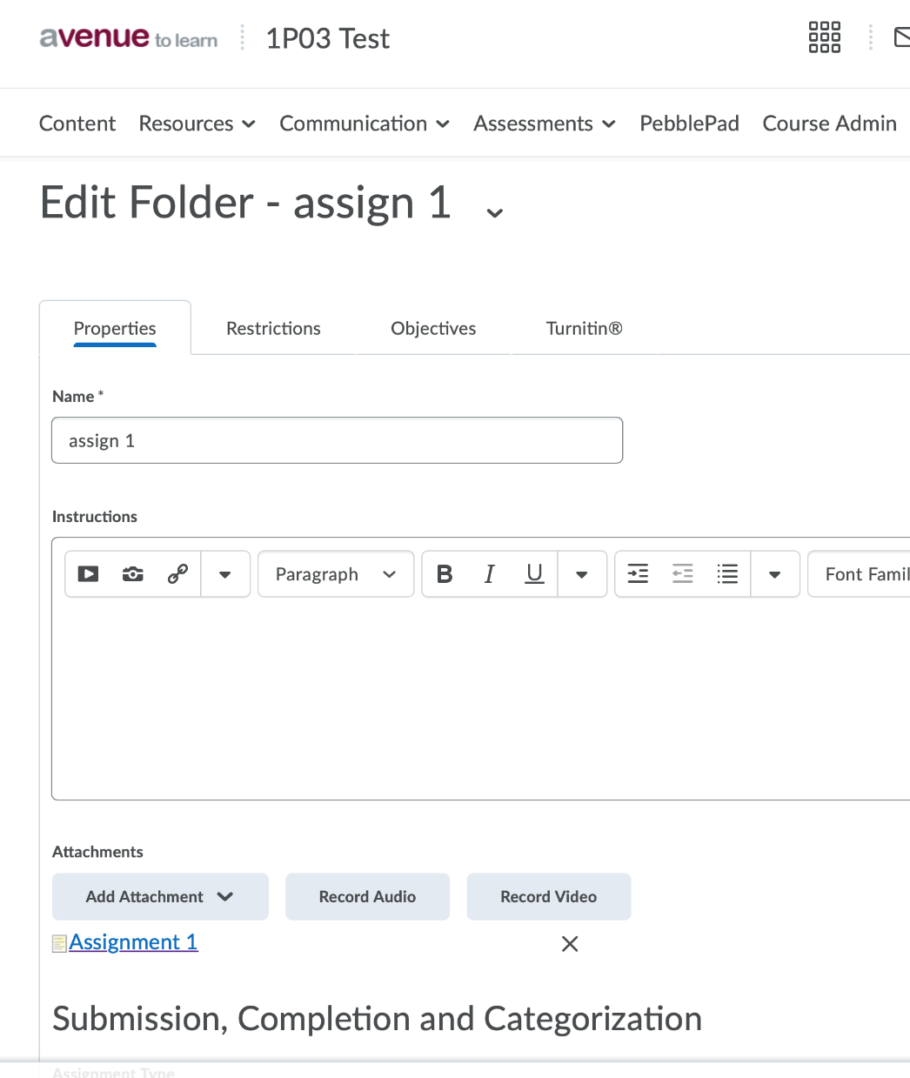
Posting Assignments
I post PDFs of my assignment specifications in a section under Content
Then I attach a link to that document in the assignment drop box itself so students have easy access to it
33:21

Slide 19
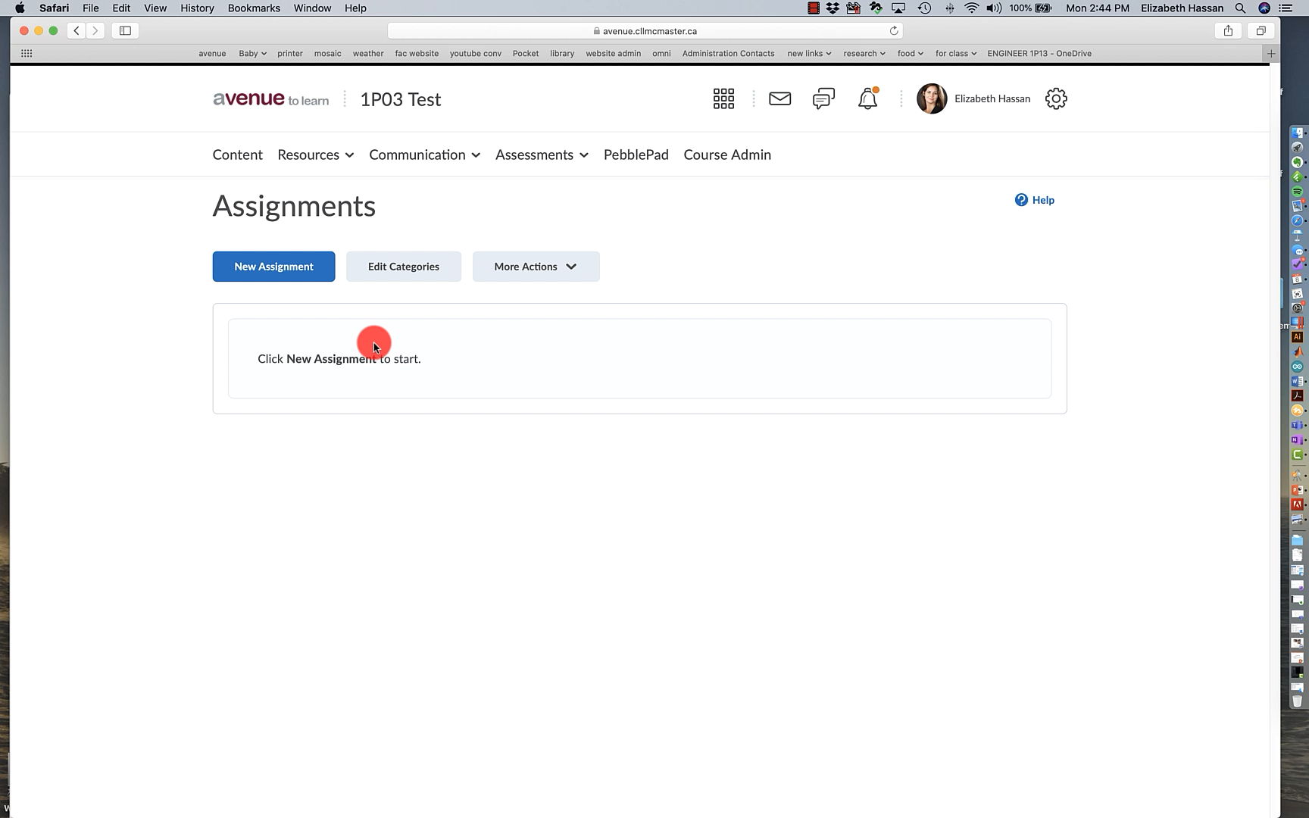
Video: Setting up an assignment
33:33

Slide 20
About Rubrics
Key advantages: students can see feedback, TAs get guidance
Makes grade entry automatic, Avenue does all the math for you
Comments:
  I use 4 level rubrics for congruence with Grad Attributes
  But you can have as many levels or criteria as you want (up to 32 criteria)
  You can override the rubric to enter values between the levels (for example half marks)
  You can copy rubrics from past courses, or duplicate rubrics within a course
34:09

Slide 21
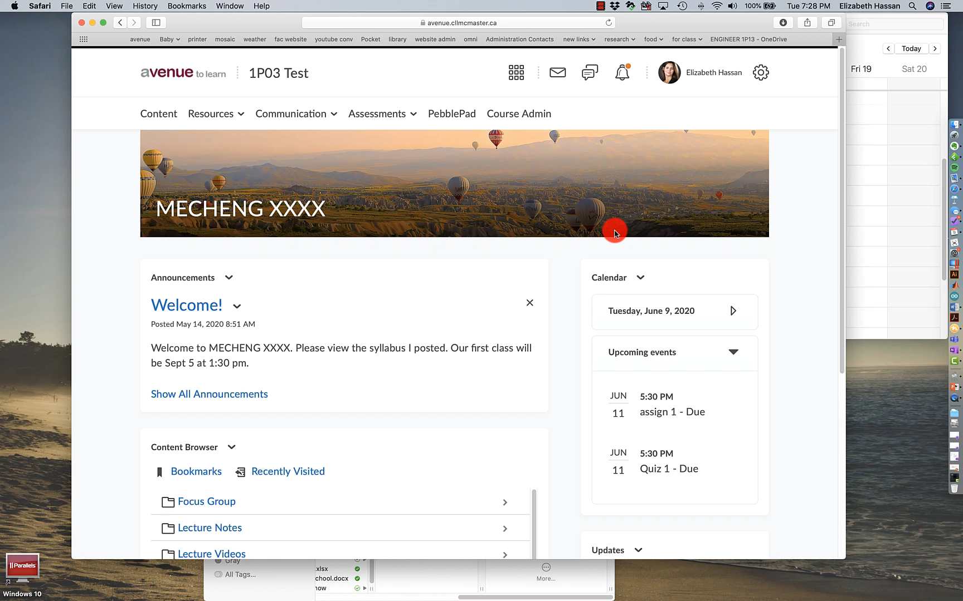
Video: Setting up a rubric
35:21

Slide 22
Method #3
Manually Entering Grades
Used for anything that doesn’t have a file to hand in
Example: grading presentations, demonstrations, peer evaluations
Comments
  Can still use a rubric, it’s just assigned to the grade item not an assignment
  Or can manually enter grades by hand
  Just like entering data into a spreadsheet, can filter by student group
35:53

Slide 23
So now I know about the different types of online assessment and I know which type suits my course
What do I do next?
36:26

Slide 24
Set up your Avenue Course:
If your course doesn’t already have an Avenue shell, request one here:
http://avenue.mcmaster.ca/course/course_request_check.php
Students are automatically added to course
You need to manually add your TAs to the course, assign them a role
36:38

Slide 25
Set up your rubrics
This is a pain unfortunately, you have to copy and paste into each of the cells
You can assign however many points you want to each category (using “Custom Points)
-Tips-
  Once a rubric has been used in your course it cannot be edited
  You can re-use rubrics, but if you do it makes it harder to use them for grad attributes, I use a separate rubric for every assignment for that reason (just make a copy)
37:04

Slide 26
Set up your grade book
Use the “setup wizard”:
I prefer weighted because it’s most similar to my course outline
-Tips-
  You can always assign an assignment to a grade item later or re-weight items if necessary
  Using categories allows you to drop the worst quiz/assignment if every item in the category has the same value
37:57

Slide 27

Best practices
Make sure you use due dates
This alerts students that something is due, prevents them from missing an assessment
38:40

Slide 28
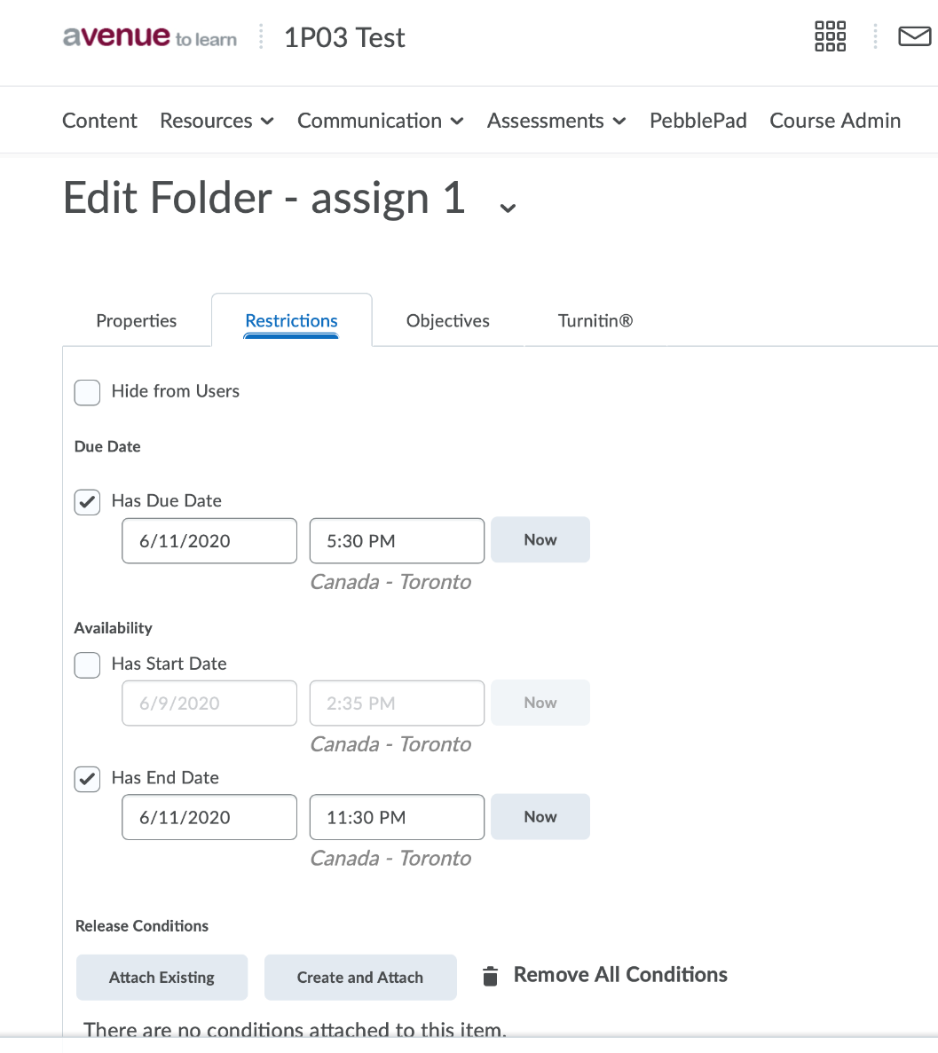
Managing Deadlines
I have a “due date” and then a later “end date”, this provides a grace period so that students can hand in a bit late if they have trouble digitizing
End date is when the drop box closes
“Special Access” is how you can allow individual students to hand in late (due to MSAF etc.)
39:09

Slide 29

Best practices
Weekly Announcements
It helps the students to keep track of work when you do a weekly announcement listing what is due that week.
You can link to assignments and other content in announcements, you don’t need to upload them again
39:57

Slide 30
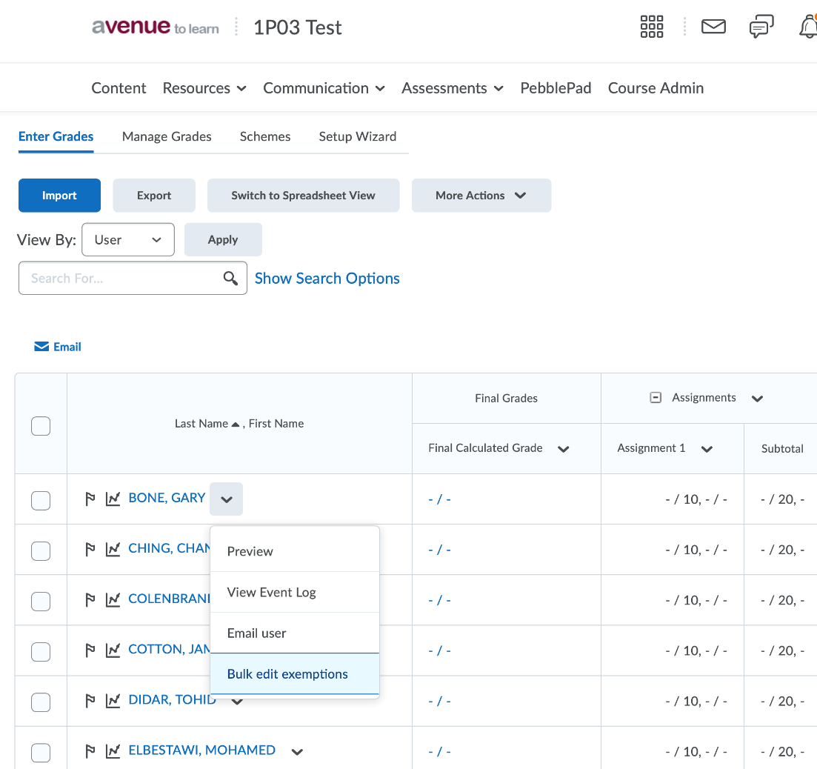
Managing Missed Work
If students miss work due to illness and are not going to complete it (e.g. if they MSAF a midterm) you can exempt them from it in the grade book
If they miss a large amount of work (e.g. multiple daily quizzes) you can Bulk Edit Exemptions to exempt them from multiple items in one step
You can Bulk Edit Exemptions by right clicking on the chevron next to their name in the grade book:
40:20

Slide 31
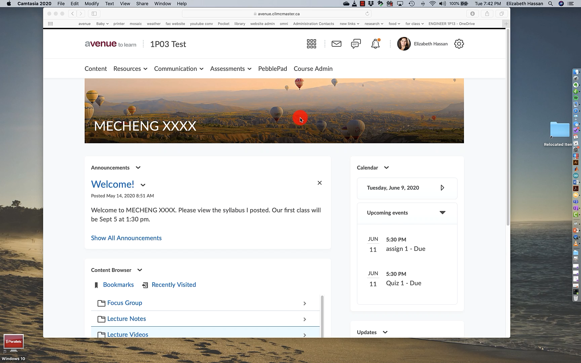
Video: Gradebook Exemptions
40:32

Slide 32
How I use Rubrics for Grad Attributes
This is not the slickest way to do it, but I think it might be the fastest
At the start of my course I go through my assignments and make sure I’m assessing all of my attributes with the right number of rubric criteria or assessments
When the work has been graded I look at the statistics to fill in the number in each category
I still have to manually enter them into the word doc unfortunately
40:57

Slide 33
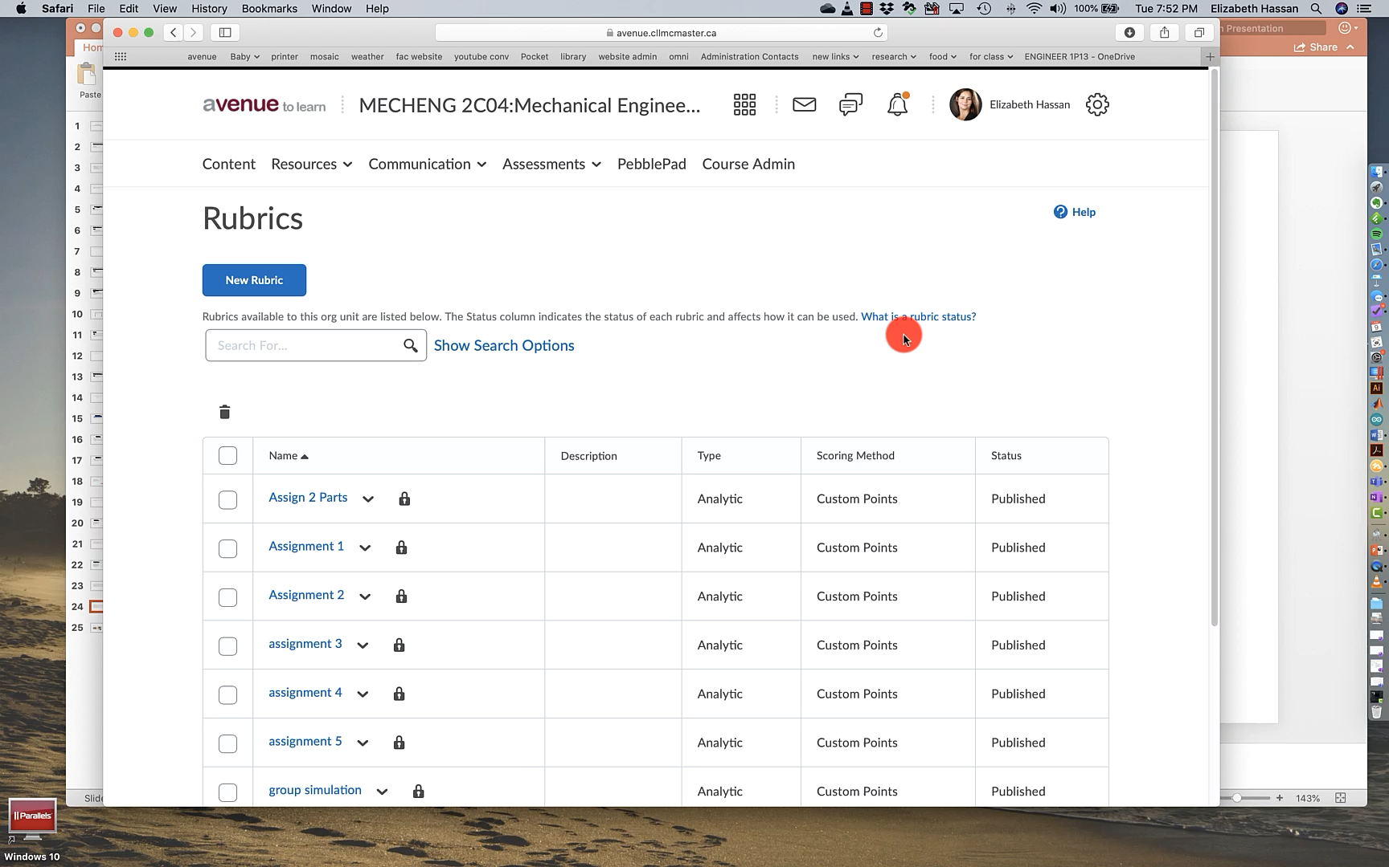
Video: Finding Rubric Statistics
41:23

Slide 34
Try it yourself:
We’ve added you to the Avenue course 1P03_Test, just a dummy Avenue shell we’ve set up
There’s an assignment and a quiz that you can take as “students” so you can see what it looks like
Neither has a deadline so you can do it anytime
You can also see your “grades” if you wonder what a grade book looks like from a student perspective
41:51

Slide 35

For the quiz:
Marilyn’s Cat, Cleo
Greg’s Cat, Smeagol
42:18

